Slide 1
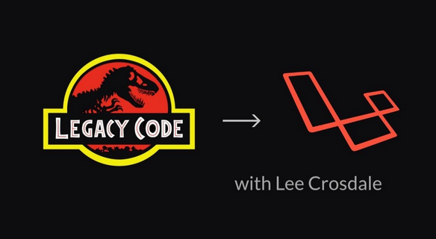
Legacy to Laravel
By Lee Crosdale

Slide 2
Introduction
My name is Lee Crosdale
Senior Web Developer for Magpie Solutions
Worked mainly with a Microsoft Stack, PHP was a hobby until more recently
Please join my hackathon at https://larahack.com

Slide 3
Talk Schedule
What is Legacy Code?
What is Laravel?
Where the project was at, at the beginning
My experience with migrating a 10 year old web application into the Laravel Framework.
The issue of where to start, mapping out the old code, and what to keep (if anything).
This is an on-going project.
If you have any suggestions, I’m all ears.
Warning:
I’ve made mistakes.

Slide 4
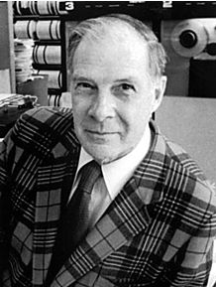
“Mathematicians stand on each others' shoulders and computer scientists stand on each others' toes.”
- Richard Hamming

Slide 5
What is Legacy?
Code that still works, but better, smarter, faster ways now exist that would provide, added value in terms of functionality and maintainability.
When a developer leaves, their code also becomes legacy.
Eventually all code becomes legacy..

Slide 6
What is Laravel?
PHP Framework - Started by Taylor Otwell
Laravel.com
Lots of libraries build up a good starting package for any web developer needs.

Slide 7
Setting: October 2016
Current System Infrastructure
Apache
MySQL 5.4
PHP 5.2 w/ Security Patches (apparently, however I didn’t ever find proof of this)
Other code was running in cron, Java, Ruby
No backups except on site daily backups
Code was managed via FTP
And then there was one..

Slide 8
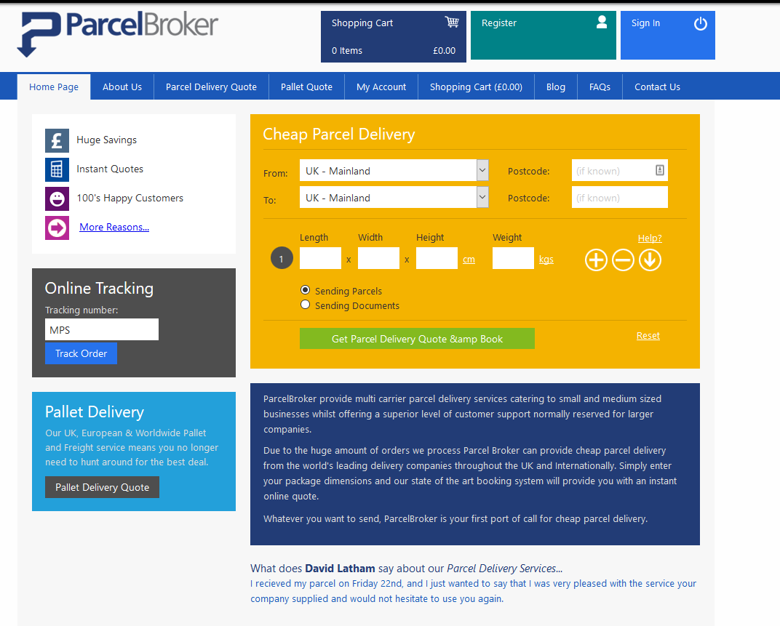

Slide 9
Moving to the cloud
I really didn’t want a dedicated box, the entire infrastructure on a single machine was scary.
For £400 a month you didn’t really get much room for anything other than the one site, other projects would be cloud hosted anyway.
Infrastructure goals:
It needed to be cost effective
We needed to have full control over the boxes
We wanted something that would do Continuous Integration (CI)
Had GIT integration
We wanted to be able to create new boxes and sites easily, preferably with some sort of pre-configured setup.

Slide 10
Moving to the cloud, the result
Cloudflare (DNS,DDos,WAF and lots of other nice things)
DigitalOcean (Cloud Server hosting that was cheap and expandable)
Laravel Forge (Create new servers, sites, with CI and GIT integration EASILY)
GitHub (Source control, worth the money over free BitBucket)

Slide 11
Moving to GIT
Relatively easy process
Ensure your copy comes from production, not from dev when copying from FTP, missing folders are a nightmare, especially if they aren’t coded to be created if they aren’t there.
Bitbucket was used for a while, but it often went down, a week after we moved to Github, BB was offline for nearly 2 days.
GitHub infrastructure is good, DDos took them down for 8 seconds..

Slide 12
The dev environment
Current time to set up a dev box was about a day, apache configs, ftp the code down etc.
Spent some time with docker, but Laravel Homestead felt like the best way to go.
Tried some other tools like Laragon, but there were some file locking issues when accessing two sites hosted locally e.g site.test calling api.site.test would cause laragon to freeze if sessions were involved.
Databases hosted on cloud

Slide 13
Moving from PHP 5.2 to 7.2
Old MySQL library is completely removed.
That worked in our favour, we created mysql functions that internally made mysqli calls.
[image wouldn’t fit here]

Slide 14
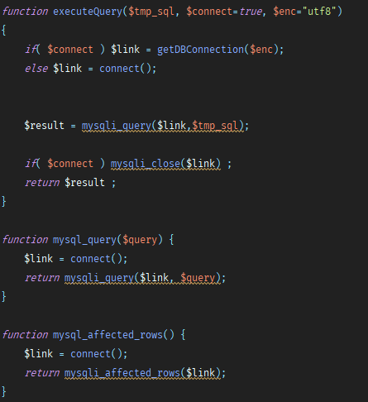

Slide 15
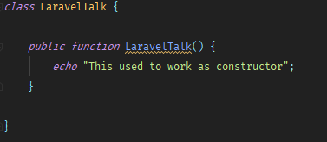
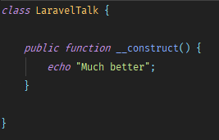
Moving from PHP 5.2 to 7.2
Part 2
One other issue was there were a few classes that constructed based off the class name.
Then Now

Slide 16
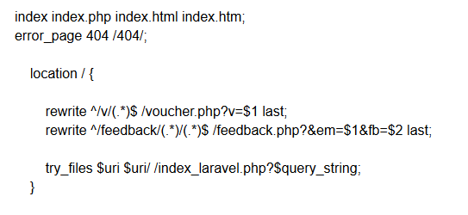
Nginx for Laravel and Legacy
Nginx is pretty easy to set up, automatically with forge.
Configured nginx to look for legacy files and then move into the laravel framework.
I also log the traffic, it’s interesting to see how many bots there are that attack.

Slide 17
DigitalOcean
1 Web Server containing files and php - 4GB - $20
1 Database Server - 4GB Server - $20
1 CDN - 1GB Server - $10
3 - $10 servers hosting various other tools and apis that we use.
A LOT cheaper than the £400 a month we were currently paying for a single dedicated box.

Slide 18
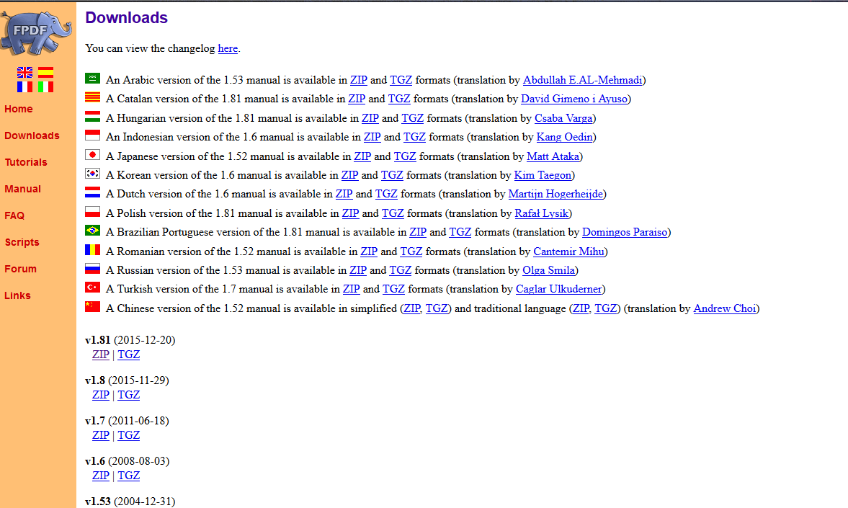

Slide 19
Beware of Third Party Libraries
(that aren’t version controlled)
Lots of PDF Libraries were used to save API data to file.
FDPF
wkHtmlToPDF
TCPDF
It’s important to document these, and make sure they are available in later PHP versions, and OS versions.

Slide 20
Quick Recap
So we have a new dev environment which setting up is a relative breeze, cloud servers, the latest PHP, GIT controlled source code and continuous integration.
Now the refactor to Laravel could begin.

Slide 21
Models
Laravel Models are a breeze to create
Overriding model constants and variables made it easy to integrate legacy tables
Timestamps
Auto model generating tools weren’t that great

Slide 22
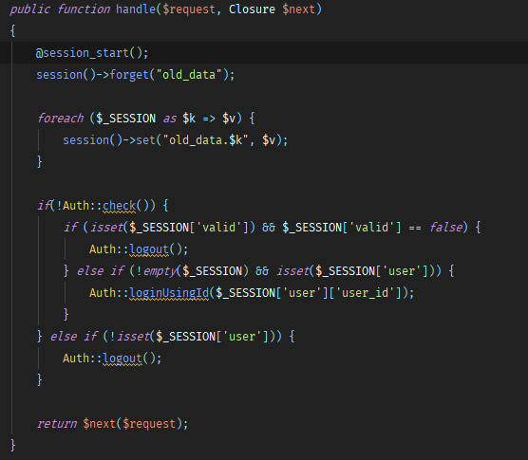
Sessions

Slide 23
Sessions Part 2
This version of Laravel uses bcrypt, so you can use password_verify in normal PHP.
Important to see security flaws, and fix those as quickly as possible
MD5 should never be used for password storage.
Password resets etc all built into the laravel auth framework.

Slide 24
S.E uh oh
Front end rewrite destroyed SEO
We needed a quick way to fix that. (Laravel to the rescue)
Mini CMS was easy to build in Laravel, and allowed a non-techie to create new pages and quickly fix any issues.
Able to create redirects, insert model data etc.
This cemented Laravel as a good framework choice.

Slide 26
Admin Panel(s)
CMS Creation meant I needed a quick admin panel (Nova wasn’t out yet)
2 Admin logins (legacy and Laravel)
Admin panel is actually a good place to start refactoring, no customer interaction.
VueJs and Laravel allowed us to internally streamline a lot of tasks.

Slide 27
Microservices
Not all code is refactorable, or at least, it’s not worth being refactored.
Microservices are a good way to get new developers up to speed with a specific issue, and allow them to take part in a legacy rewrite.
Con is that there is another codebase to maintain
With no legacy code, it’s all clean Laravel.
Simply build a rest class named ‘x’ and you strip out the legacy code and replace it with the new rest API microservice.
You can extend those Microservices out to customers or increase value for service.

Slide 28
File Storage
Not a tackled issue yet.
DigitalOcean Spaces is where we are headed (S3 framework)
Once this issue is sorted, we can easily start load balancing the site.
Spaces is easy to use.

Slide 29
Artisan Tasks
Able to replicate cron tasks in Java and Ruby really easily with Laravel/PHP
It’s nice having the whole Laravel framework in cron since there isn’t much it can’t do
Don’t use Artisan tasks to import data, build those into Seeder classes and run those, unless you need parameters, then do use Artisan tasks.

Slide 30
Where we are now
Talk covers about 2 years of development
300,000 lines of code either deleted or refactored into laravel.
It’s common to hear ‘Just re-write it’, but consider the time and energy it took to code in the first place before making that attempt.
10 years of legacy code is still probably 10 years of refactoring.
If legacy works, don’t lose features for the sake of upgrading the code.
Customers == cashflow, don’t annoy them, they don’t care that the framework is MVC if they lose an important feature.
Next time I will follow a more Test Driven Development, Laravel tests have improved lately(Dusk)
Moving infrastructure improved uptime drastically.

Slide 31
Thanks!
Any Questions?
Contact me:
https://leecrosdale.com
twitter.com/leecrosdale

